Slide 1
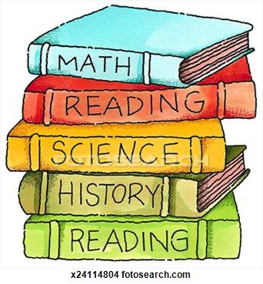
Orange Words

Slide 2
at

Slide 3
was

Slide 4
get

Slide 5
did

Slide 6
all

Slide 7
what

Slide 8
came

Slide 9
say

Slide 10
as

Slide 11
they

Slide 12
our

Slide 13
out

